Slide 1
Distributed Systems
System Models

Slide 2
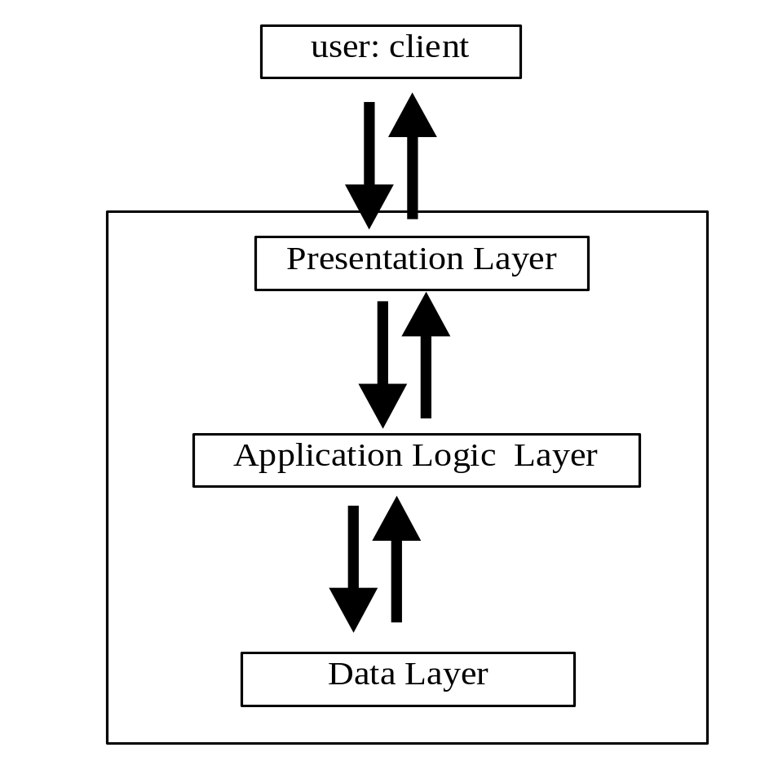
Example: e-Business application
Architecture: structure in terms of separate specified component.
GUI , Webpage, …
Business rules,
Operations, …
Layers might exist in the mind
Of the designer

Slide 3
Presentation Layer
Facilitate interaction with the user (human or software)
-Service for price checking
-currency converter
user of the presentation layer submits operations and get responses.
The boundary between P layer and client can be very thin. For example, Java Applet

Slide 4
Application Logic Layer (ALL)
Before the delivery of the result some data processing is required.
Processing is the implementation of the information required by the client of the P. layer
ALL are all those programs and module involved in processing the operation
Example: Bank Cash Machine
Application Logic also called Business process, Business logic

Slide 5
Single Tier: all three into a single component
Presentation
Dumb Terminal
Mostly in Mainframes from the days that:
  640K ought to be enough for anybody.
  “I think there is a world market for maybe five computers”.
Application
Logic
Data
webserver

Slide 6
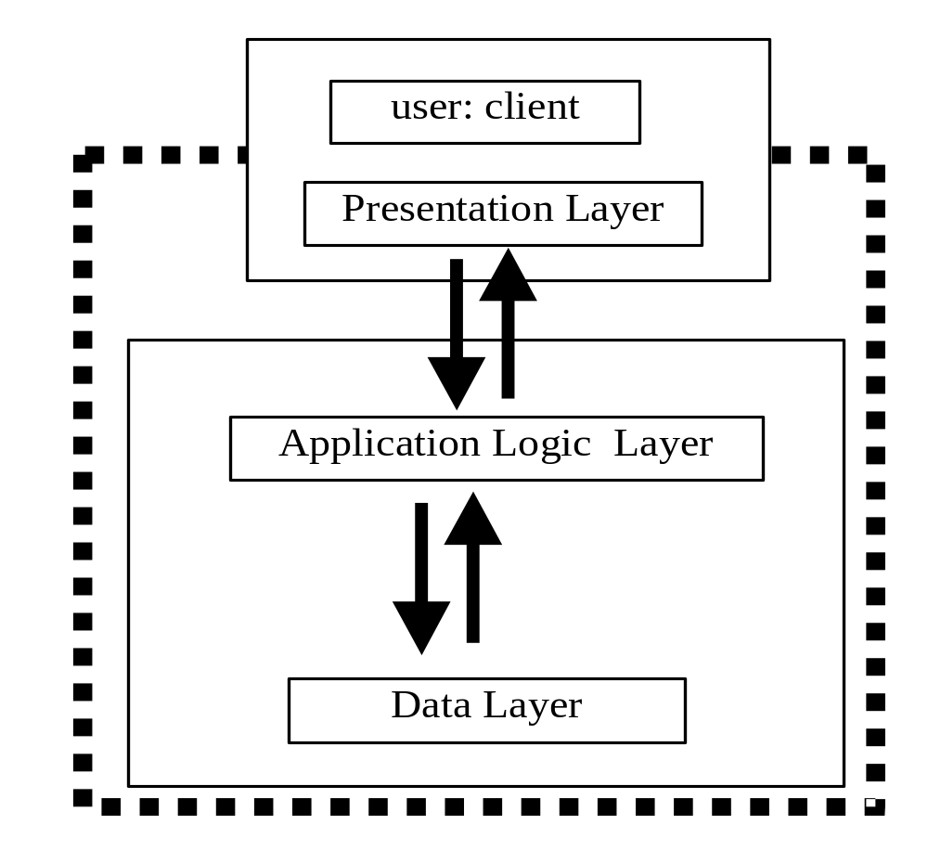
2-tier Architecture
Birth of PC:
Small computer (PC)
Large computers (Server,
Mainframe)
Fat Client VS. Thin Client
The idea of API ☺
Remote Procedure Call

Slide 7
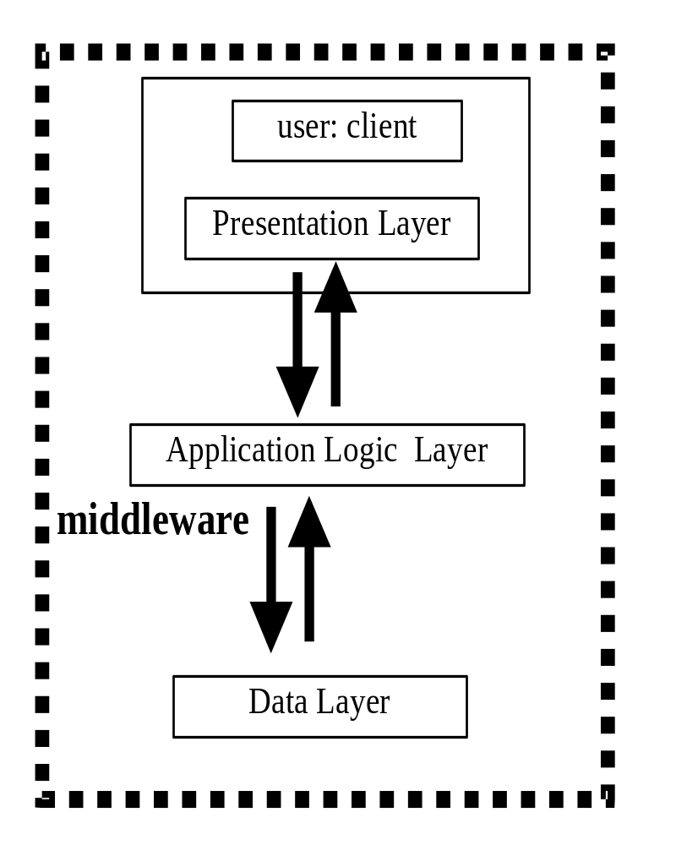
Three Tier
Infrastructure that supports the
development of ALL is called a
middleware
Sun RPC
Java RMI (Remote Method Inv.)
SOAP (which is RPC based)
CORBA,
JMS (Java Messaging Services)
Data Layer resulted in better
interfaces
ODBC (Open DB Connectivity)
JDBC (Java …)

Slide 8
N Tier
Many Distributed Systems (3-Tiers) interacting.
Notice: phrase Tier can also imply physical separation of components, i.e. on various hardware (Physical Tier vs. Logical Tier
Now,
Question: what is the underlying model?
  Study of architecture to ensure the system meets preset and future demand

Slide 9
Service Layers in a Distributed System
Hardware+network+OS=platform
Middleware:
  Mask heterogeneity
  Programming model
  Provides building blocks
Applications, services
Middleware
Operating system
Computer and network hardware

Slide 10
Architectural Models of Distributed Systems
Functions of components
  Processes vs objects
The placement of components across a network
  Distribution of data
  Distribution of workload
Inter-relationships between components
  Functional roles
  Communication patterns

Slide 11
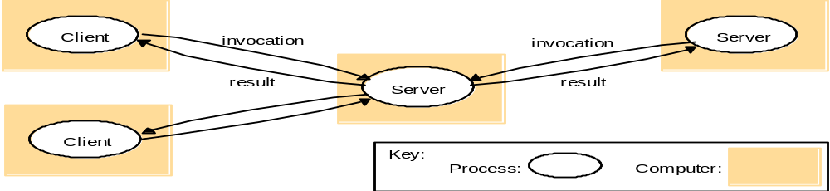
System Architectures
The Client-Server Model
  Server: process that accepts requests to perform a service and responds accordingly
  Client: invokes services (remote invocation)
Or
  Client object invoke a method upon a server object
Server may be a client of other servers
  web server is a client to: a file server, a DNS server
  Search engines-web crawlers-web servers

Slide 12
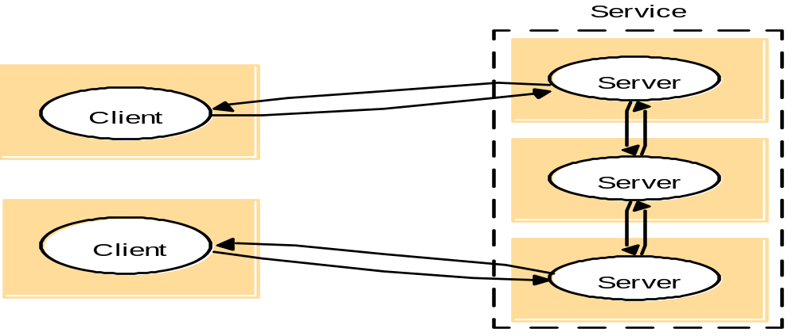
Multiple Servers
Partition services (e.g. web servers)
Replication for performance and fault tolerance

Slide 13
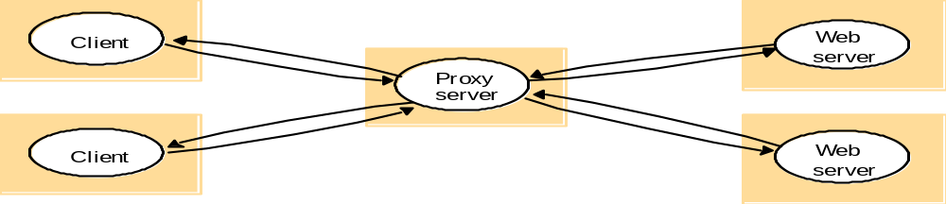
Proxy Servers and Caches
Cache: a store of recently used data objects that is closer than the objects themselves
Proxy server: a shared cache of web resources for the client machine at a site or across sites
  May also be used to access remote web servers through a firewall

Slide 14
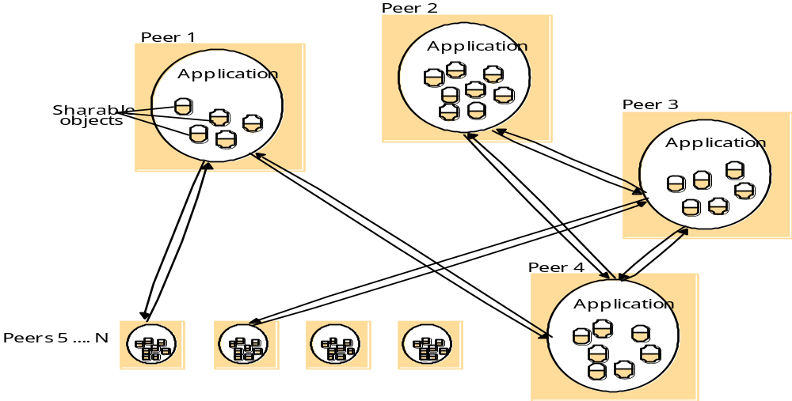
Peer processes
All of the processes play similar roles
Cooperate as peers to perform a distributed activity
Reduces server bottlenecks
Consistency and synchronisation issues

Slide 15
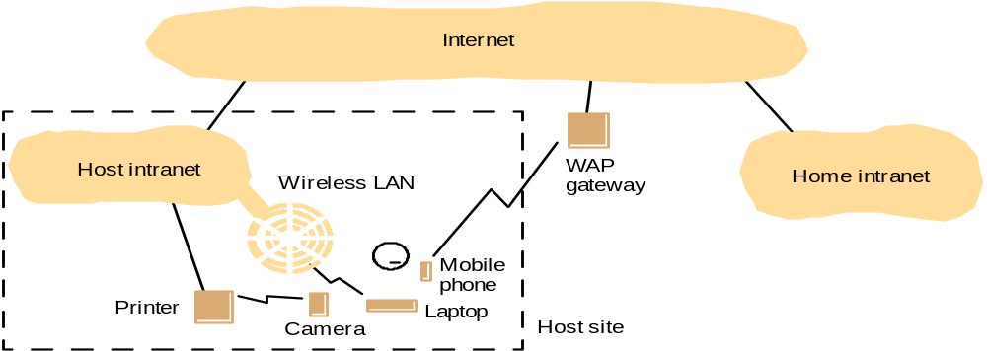
Variations of the client-server model
Variations due to:
  Need to use mobile code (e.g. applets and agents)
  Need for low cost computers with limited hardware resources (network computers vs thin clients)
  Need to add and remove mobile devices

Slide 16
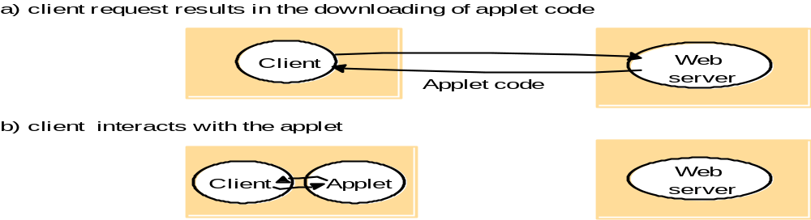
Variations
Example mobile code: Applets
Thin clients
Compute server
Network computer or PC
Thin
network
Application
Client
Process

Slide 17
Design Requirements for DSs
Judging how good the architecture is...
Performance
  how fast will it respond?
Quality of Service
  are video frames and sound synchronised?
Dependability
  does it work correctly?

Slide 18
Performance
Responsiveness
  fast interactive response delayed by remote requests
  use of caching, replication
Throughput
  dependent on speed of server and data transfer
Load balancing
  use of applets, multiple servers

Slide 19
Quality of Service (QoS)
Non-functional properties experienced by users:
Deadline properties
  hard deadlines (must be met within T time units)
  soft deadlines (`there is a 90% chance that the video frame will be delivered within T time units)
    multimedia traffic, video/sound synchronisation
    depend on availability of sufficient resources
Adaptability
  ability to adapt to changing system configuration

Slide 20
Dependability
Correctness
  correct behaviour wrt specification
  e.g. use of verification
Fault-tolerance
  ability to tolerate/recover from faults
  e.g. use of redundancy
Security
  ability to withstand malicious attack
  e.g. use of encryption, etc

Slide 21
Fundamental Models
Questions
  What are the main entities in the system?
  How do they interact?
  What are the characteristics that affect their individual and collective behaviour?
Purpose:
  Specify assumptions
  Make generalisations
Interaction, Failure, Security

Slide 22
Interaction Model
Distributed algorithms – including communication
  Non-deterministic behaviour
Important factors
  Performance of communication channels (latency, bandwidth, jitter)
  Clocks and timing events
Synchronous…
  Computation, communication and clock drifts within known lower and upper bounds
…vs Asynchronous: non-determinisc

Slide 23
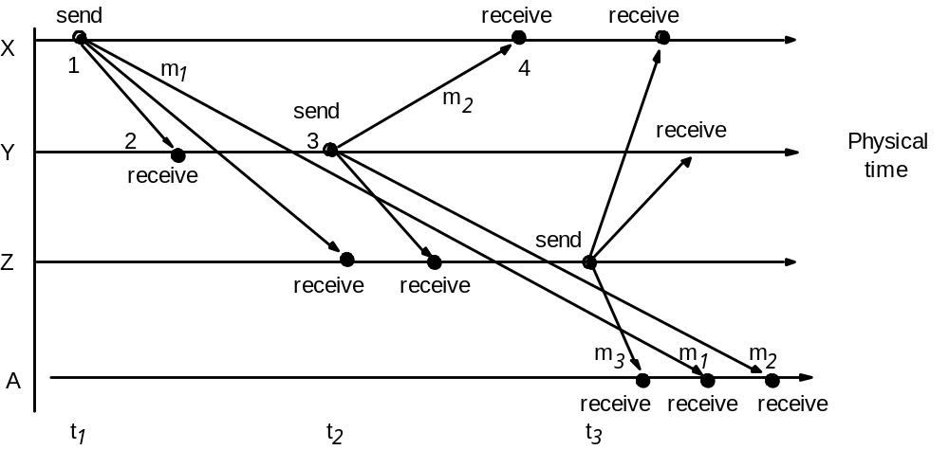
Event Ordering
1. X sends email with subject “meeting”
2. Y and Z reply by sending a message with the subject Re: meeting”
(YZ reads both X and Y’s messages)

Slide 24
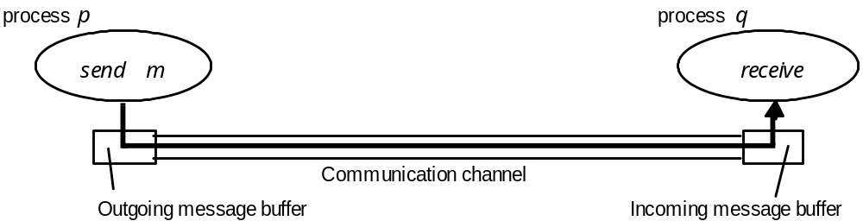
Failures

Slide 25
Omission and arbitrary failures
Class of failure
Affects
Description
Fail-stop
Process
Process halts and remains halted. Other processes may
detect this state.
Crash
Process
Process halts and remains halted. Other processes may
not be able to detect this state.
Omission
Channel
A message inserted in an outgoing message buffer never
arrives at the other end’s incoming message buffer.
Send-omission
Process
A process completes a
send,
but the message is not put
in its outgoing message buffer.
Receive-omission
Process
A message is put in a process’s incoming message
buffer, but that process does not receive it.
Arbitrary
Process or
Process/channel exhibits arbitrary behaviour: it may
(Byzantine)
channel
send/transmit arbitrary messages at arbitrary times,
commit omissions; a process may stop or take an
incorrect step.

Slide 26
Timing failures
Class of Failure
Affects
Description
Clock
Process
Process’s local clock exceeds the bounds on its
rate of drift from real time.
Performance
Process
Process exceeds the bounds on the interval
between two steps.
Performance
Channel
A message’s transmission takes longer than the
stated bound.

